Slide 1

Security+
Exam SY0-601
Chapter 23
Identity and Account Management Controls
Notes:
Gain Attention

Slide 2
Chapter 23 (Domain 3.7) Learning Objectives
Implement identity and account management controls.
Identity
Identity provider (IdP)
Attributes
Certificates
Tokens
SSH keys
Smart cards
Account types
User account
Shared and generic accounts/credentials
Guest accounts
Service accounts
Account policies
Password complexity
Password history
Password reuse
Network location
Geofencing
Geotagging
Geolocation
Time-based logins
Access policies
Account permissions
Account audits
Impossible travel time/risky login
Lockout
Disablement

Slide 3
Identity
Identification is the process of ascribing a computer ID to a specific user, computer, network device, or computer process.
The identification process is typically performed only once, when a user ID is issued to a particular user.
User identification enables authentication and authorization to form the basis for accountability.
For accountability purposes, user IDs should not be shared, and for security purposes, user IDs should not be descriptive of job function.
This practice enables you to trace activities to individual users or computer processes so that users can be held responsible for their actions.
Identification usually takes the form of a logon ID or user ID that must be unique.

Slide 4
Identity Provider (IdP)
The term Identity Provider (IdP) is used to denote a system or service that creates, maintains, and manages identity information.
IdPs can range in scale and scope—from operating for a single system to operating across an enterprise.
Additionally, they can be operated locally, distributed, or federated, depending on the specific solution.
Multiple standards have been employed to achieve these services, including those built on the Security Assertion Markup Language (SAML), OpenID, and OAuth.
These standards are covered in Chapter 24, “Implement Authentication and Authorization.”

Slide 5
Attributes
Identity attributes are the specific characteristics of an identity—name, department, location, login ID, identification number, e-mail address, and so on—that are used to accurately describe a specific entity.
These elements are needed if one is to store identity information in some form of directory, such as an LDAP directory.
The particulars of a schema need to be considered to include attributes for people, equipment (servers and devices), and services (apps and programs), as any of these can have an identity in a system.
The details of schemas have already been taken care of via Active Directory, various IdPs, and so on, so this is not something that needs to be created; however, it does need to be understood.

Slide 6
Certificates
Certificate-based authentication is a means of proving identity via the presentation of a certificate.
Certificates offer a method of establishing authenticity of specific objects such as an individual’s public key or downloaded software.
A digital certificate is a digital file that is sent as an attachment to a message and is used to verify that the message did indeed come from the entity it claims to have come from.
Using a digital certificate is a verifiable means of establishing possession of an item (specifically, the certificate).
When the certificate is held within a store that prevents tampering or extraction, this becomes a reliable means of identification, especially when combined with an additional factor such as something you know or a biometric.

Slide 7
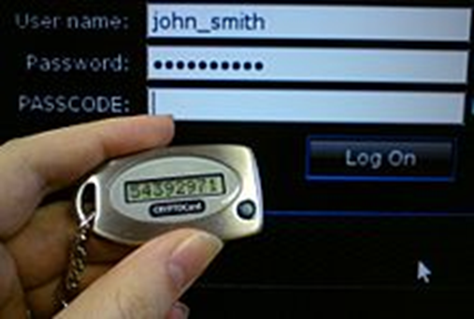
Tokens
An access token is a physical object that identifies specific access rights and, in authentication, falls into the “something you have” factor.
RFID cards and proximity readers
Smart cards
Hardware tokens

Slide 8
SSH Keys
SSH keys are access credentials used by the Secure Shell (SSH) protocol.
They function like usernames and passwords, but SSH keys are primarily used for automated processes and services.
SSH keys are also used in implementing single sign-on (SSO) systems used by system administrators.
SSH keys are exchanged using public key cryptography, and the keys themselves are digital keys.

Slide 9
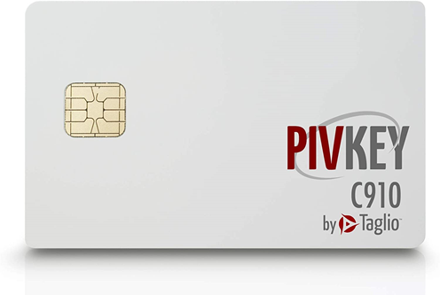
Smart Cards
Smart cards are devices that store cryptographic tokens associated with an identity.
The form factor is commonly a physical card, credit card sized, that contains an embedded chip that has various electronic components to act as a physical carrier of information.
PIV
CAC

Slide 10
Account Types
To manage the privileges of many different people effectively on the same system, a mechanism for separating people into distinct entities (users) is required, so you can control access on an individual level.
It’s convenient and efficient to be able to lump users together when granting many different people (groups) access to a resource at the same time.
At other times, it’s useful to be able to grant or restrict access based on a person’s job or function within the organization (role).
While you can manage privileges on the basis of users alone, managing user, group, and role assignments together is far more convenient and efficient.

Slide 11
User Account
User account refers to the account credentials used when accessing a computer system.
This is generally the lowest level addressed by privilege management and the most common area for addressing access, rights, and capabilities.
Each user is generally given a user ID—a unique alphanumeric identifier they will use to identify themselves when logging in or accessing the system.
Combination of the user’s first, middle, and last names and often include numbers

Slide 12
User Account
In general, a user wanting to access a computer system must first have a user ID created for them on the system they wish to use.
This is usually done by a system administrator, security administrator, or other privileged user, and this is the first step in privilege management—a user should not be allowed to create their own account.
Once the account is created and a user ID is selected, the administrator can assign specific permissions to that user.

Slide 13
User Account
Account policy enforcement is an important part of user credential systems.
Managing credentials begins with policies that state the desired objectives.
Key elements of a policy include prohibition of sharing accounts and of generic accounts not assigned to a user.
For users who have multiple roles, multiple accounts may be necessary, but these need to be delineated by policy rather than on an ad hoc basis.
Credential management rules, such as password policy, should be enacted, including lockout and recovery procedures.
When users no longer are authorized, such as when they leave the firm or change jobs, their accounts should be disabled, not removed.

Slide 14
Shared and Generic Accounts/Credentials
Shared accounts, sometime called generic accounts, go against the specific premise that accounts exist so that user activity can be tracked.
There are times that shared accounts are used for groups like guests
Sometimes the shared accounts are called generic accounts and exist only to provide a specific set of functionalities, such as in a PC running in kiosk mode, with a browser limited to accessing specific sites as an information display.
Under these circumstances, being able to trace the activity to a user is not particularly useful.

Slide 15
Shared and Generic Accounts/Credentials
A common form of a shared account is one created to run nightly batch operations.
As every action must be associated to a user account, a shared account in the name of a batch user can be used to run batch jobs.
This is a generic set of credentials, not actually associated with a single person but rather associated with a particular type of process (batch jobs, backups, and so on).
These credentials are maintained by administrators but are reserved for specific uses.

Slide 16
Guest Accounts
Guest accounts are frequently used on corporate networks to provide visitors access to the Internet and to some common corporate resources, such as projectors, printers in conference rooms, and so forth.
Again, like generic accounts, these types of accounts are restricted in their network capability to a defined set of machines, with a defined set of access, much like a user visiting the company’s public-facing website via the Internet.
As such, logging and tracing activity have little to no use, so the overhead of establishing a unique account does not make sense.

Slide 17
Service Accounts
Service accounts are accounts that are used to run processes that do not require human intervention to start, stop, or administer.
From running batch jobs in the data center to executing simple tasks that an organization must complete for purposes of regulatory compliance; many reasons exist for running processes with service accounts that don’t require an account holder.
From a security perspective, administrators can configure service accounts to minimize risks associate with them.
Any service account that has to run in an elevated privilege mode can be designated to receive extra monitoring and scrutiny.

Slide 18
Account Policies
The key method used to control access to most systems is still one based on passwords. In conjunction with a strongly enforced account policy that prohibits sharing of passwords and credentials, use of passwords forms the foundation to support the concept that each user ID should be traceable to a single person’s activity.
Passwords need to be managed to provide appropriate levels of protection.
They need to be strong enough to resist attack, and yet not too difficult for users to remember.
An account policy can act to ensure that the necessary steps are taken to enact a secure password solution, both by users and by the password infrastructure system.

Slide 19
Password Complexity
Every organization should have defined password complexity requirements that passwords must meet.
Typical requirements specify that the password must meet the minimum length requirement and have characters from at least three of the following four groups:
English uppercase characters (A through Z),
English lowercase characters (a through z),
numerals (0 through 9), and
nonalphabetic characters (such as !, $, #, and %).
Relying on passwords alone is no longer sufficient.

Slide 20
Password History
Password history refers to passwords previously used by an account.
Enforce password history
Tells the system how many passwords to remember and does not allow a user to reuse an old password in that list
Maximum password age
Specifies the maximum number of days a password may be used before it must be changed
Minimum password age
Specifies the minimum number of days a password must be used before it can be changed again

Slide 21
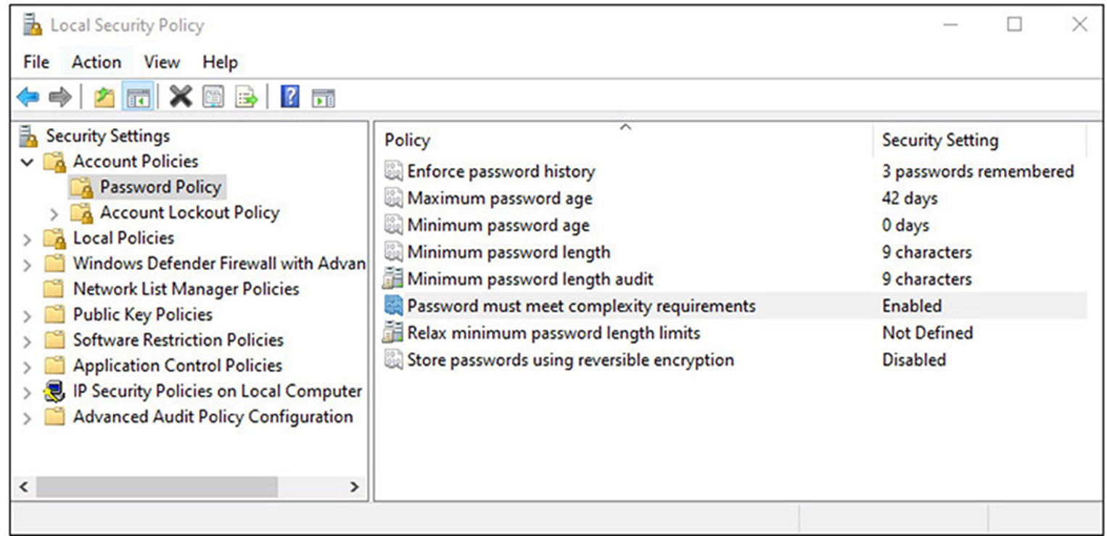
Password History

Slide 22
Password Reuse
Password reuse is a bad idea in that it reopens an exposure to an adversary who has previously obtained a password.
Official guidance is passwords should not be reused for at least a year, and for at least a half-dozen changes, whichever comes last.
Practically, we should never reuse passwords—for a single account or between accounts.
Adopting a policy of no reuse makes good sense from a risk perspective.
This is to minimize the opportunity for an adversary to take advantage of a reuse case.

Slide 23
Time of Day
Creating time-of-day restrictions for access can solve many account management problems.
Reduces the attack surface for attackers.
This is even more important for privileged users.
You can set logon time limits for a user in Windows using an administrative command prompt with the following syntax:
net user <username> /time:<day>,<time>
Alternatively, in a domain environment, you can also set logon hour restrictions in Active Directory through Group Policy and Group Policy Objects (GPOs).

Slide 24
Network Location
Having restrictions for accounts based on the network location can be a very powerful tool in limiting attack surfaces against privileged accounts.
Prohibiting specific types of access based on where on the network a user is currently located will prevent someone from using the CFO’s credentials from the manufacturing floor, or the head of HR from a kiosk in the lobby.
While this might on rare occasion prevent the legitimate user from performing actions under these circumstances, this is a small price to pay for the blanket protection of privileged account access.

Slide 25
Geofencing
Geofencing is the use of the Global Positioning System (GPS) and/or radio frequency identification (RFID) technology to create a virtual fence around a particular location and detect when mobile devices cross the fence.
This enables devices to be recognized by others, based on location, and have actions taken.
Geofencing is used in marketing to send messages to devices that are in a specific area such as near a point of sale, or just to count potential customers.
Geofencing has been used for remote workers, notifying management when they have arrived at remote work sites, allowing things like network connections to be enabled for them.
The uses of geofencing are truly only limited by one’s imagination.

Slide 26
Geotagging
Geotagging is the process of applying geotags (location information) to a specific item.
The actual geotags can be in a variety of formats but are typically some form of an encoding of latitude and longitude.
photographs, videos, websites, and items posted on social media sites.
Closely related is the concept of geocoding, which refers to the use of non-coordinate-based geographic metadata elements such as physical street addresses or building locations.
Together these elements can provide a significant level of utility to various services, allowing them to customize things based on the location of the device, service, or user.

Slide 27
Geotagging
Geotags have been used in many investigations, as many photos have geotag information embedded in the metadata at the time of creation.
This data can be read by special utilities that can read the exchangeable image file (EXIF) or extensible metadata platform (XMP) formats.

